Slide 1
Module - VI: Multi-Model Prompting: Introduction to Multi-model Prompting, Text + Image Prompts, Cross-model AI interaction.
Introduction

Slide 2
Multi-Model Prompting
Multi-Model Prompting means using more than one AI model together to solve a task instead of relying on a single model.
Regular : One prompt → One model → One output
Multi-Model prompt : One task → Multiple models → Combined / verified output

Slide 3
Process
Multi-Model Prompting is a technique where:
Different AI models are given the same or different prompts
Their outputs are compared, combined, or verified
The final answer is selected or synthesized

Slide 4
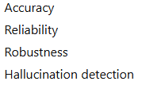
Why Use Multi-Model Prompting?
Because:
One model may hallucinate
One model may be better at reasoning
One model may be better at coding
One model may be better at creativity
Improves :

Slide 5
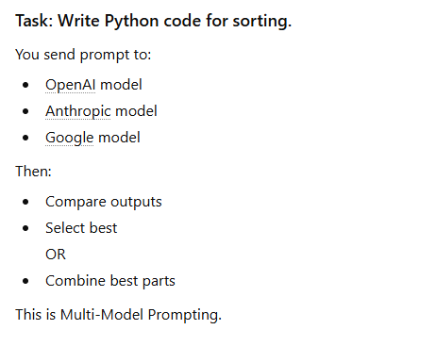

Slide 6
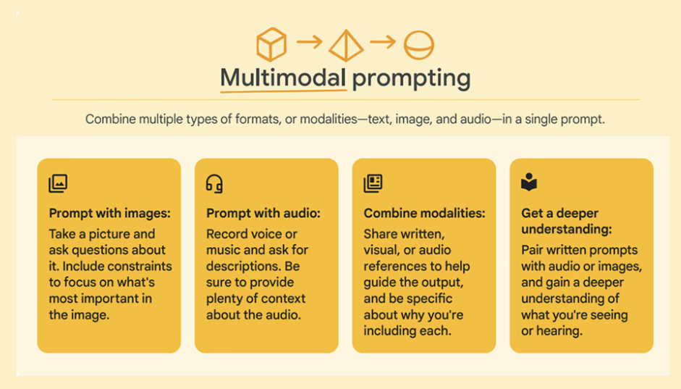

Slide 7
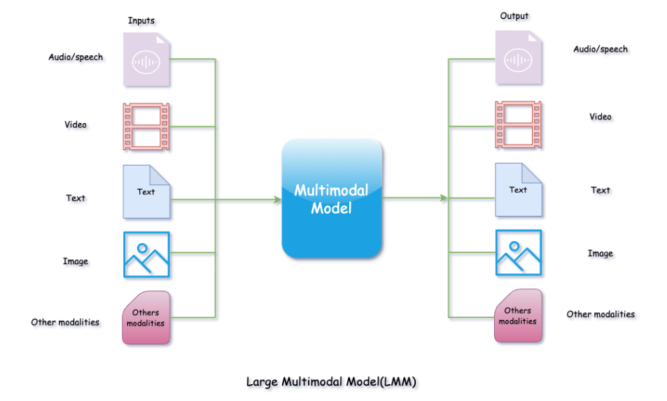

Slide 8
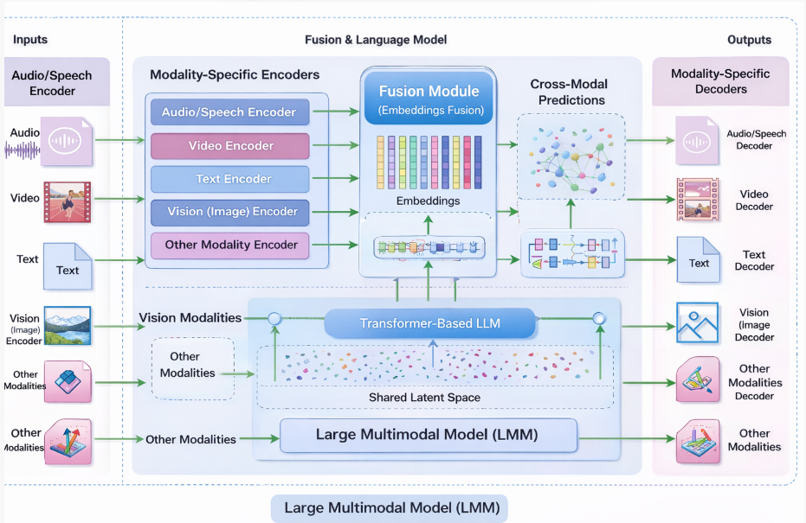

Slide 9
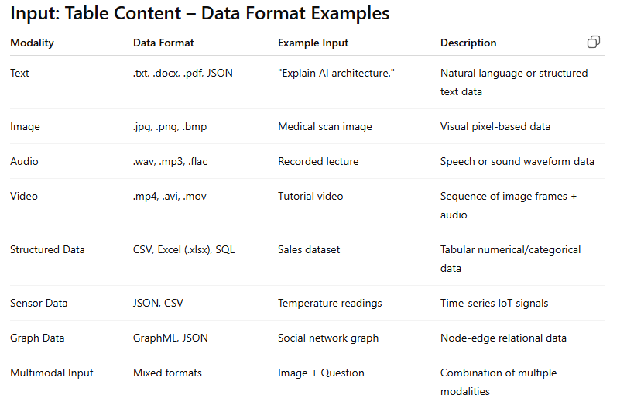

Slide 10
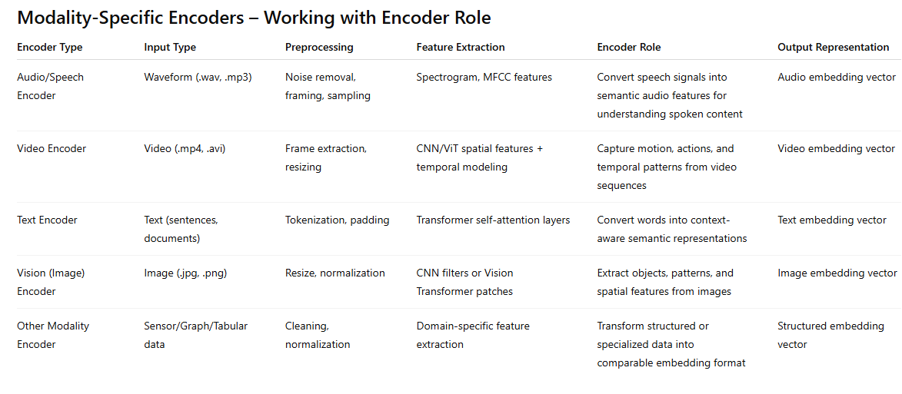

Slide 11
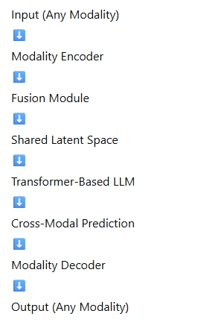
Fusion Module
The Fusion Module is the component in a Large Multimodal Model that:
Receives embeddings from different modality-specific encoders
Combines them into a unified representation
Aligns them into a shared latent space
Enables cross-modal reasoning
It acts as the integration layer of the system.

Slide 12
Why Fusion Is Needed
Each encoder produces a different type of embedding:
Image → Visual feature vector
Text → Semantic token vector
Audio → Acoustic feature vector
Video → Spatio-temporal vector
These embeddings:
Have different structures
Come from different feature spaces
Cannot be directly compared
The Fusion Module converts them into a common semantic space.

Slide 13
The Fusion Module receives embeddings from different modality-specific encoders and aligns them into a shared latent space.
It combines features using attention or projection mechanisms, enabling cross-modal reasoning.
This allows the model to understand relationships between text, images, audio, and video, and generate context-aware outputs.
Common fusion methods:
Concatenation
Cross-attention
Multimodal transformers
Projection layers
Gated fusion networks

Slide 14
A Shared Latent Space is the common representation layer inside multimodal AI models.
It is called the central intelligence layer because all different types of data are converted into the same internal numerical format (embeddings) before reasoning happens.

Slide 15
Image + Text Reasoning
Example:
Image: A dog playing in snow
Text: “What is the animal doing?”
The image encoder converts the image into a vector. The text encoder converts the question into a vector.
Since both are in the same space → The model connects “dog” + “playing” + “snow” and answers correctly.

Slide 16
Audio + Text Understanding
Example:
Audio: Someone says “Turn off the lights”
Text instruction system processes it.
Speech → converted into embedding Text commands → same embedding space
Now the model understands spoken language as text meaning.
This is how voice assistant's work.

Slide 17
Video + Question Answering
Video = sequence of image frames + audio
Each frame → embedding Audio → embedding Question → embedding
All combined in shared latent space → Model reasons across time and modality.
Example: “Why did the man run?” Model looks at earlier frames in the same embedding space and finds the cause.

Slide 18
Different encoders:
CNN / Vision Transformer → image embeddings
Transformer → text embeddings
Audio encoder → speech embeddings
Then:

Slide 19
Transformer-Based LLM (Core Brain)
At the center is a Transformer-based Large Language Model.
This module:
Performs reasoning
Generates responses
Understands relationships
Produces cross-modal predictions
It acts as the cognitive engine of the system.

Slide 20
Cross-Modal Predictions
After processing, the model generates:
Context-aware outputs
Predictions combining multiple input types
Example:
Image + Question → Text answer
Text → Image
Audio → Text summary

Slide 21
Modality-Specific Decoders (Right Side)
The output is passed to decoders that convert embeddings back into the required format:
Audio Decoder → Speech output
Video Decoder → Generated video
Text Decoder → Written response
Vision Decoder → Image generation
Other Decoders → Structured output

Slide 22
Types of Multi-Model Prompting
Level 1: Sequential Prompting
Output of Model A → Input of Model B
Example: Image model detects objects → Language model explains scene.
Level 2: Parallel Prompting
Multiple models process same input → Results combined
Example: One model analyzes sentiment Another extracts keywords Final model merges both.
Level 3: Hierarchical Prompting
Main controller model assigns tasks to sub-models.
Example: Agent model → Calls math model, coding model, vision model.
Level 4: Ensemble Prompting
Multiple models generate answers → Best output selected.
Used in:
Research systems
High accuracy prediction
Evaluation frameworks

Slide 23
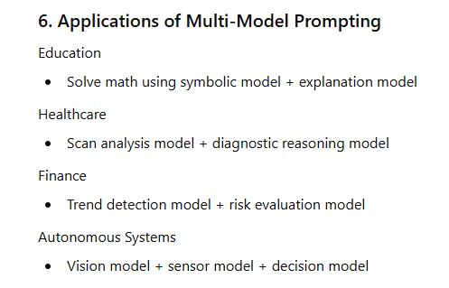

Slide 24
Advanced Prompt Types in Multi-Model Systems
Routing Prompt “Identify if this is a coding, math, or medical question.”
Decomposition Prompt “Break this complex task into smaller subtasks.”
Verification Prompt “Verify the correctness of this answer.”
Self-Reflection Prompt “Analyze your previous answer and improve it.”
Aggregation Prompt “Combine the outputs from Model A and Model B into a final summary.”

Slide 25
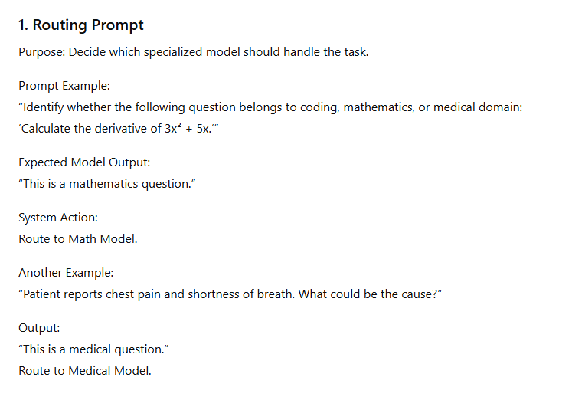
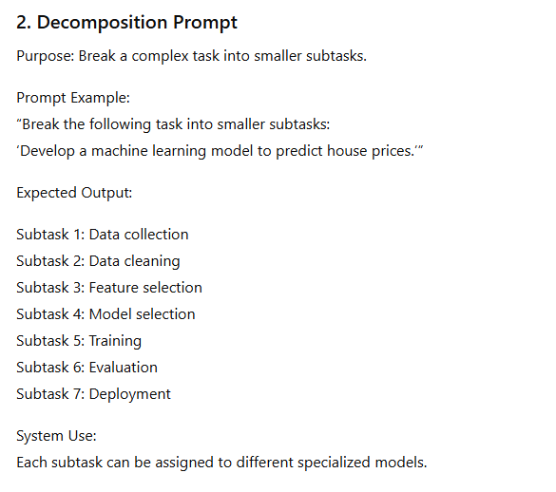

Slide 26
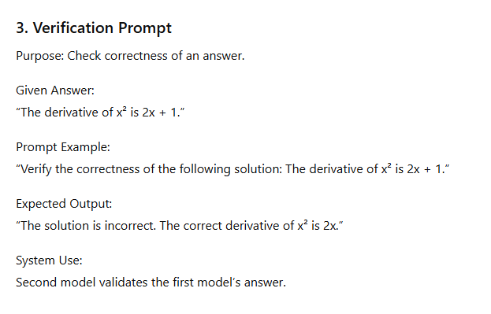
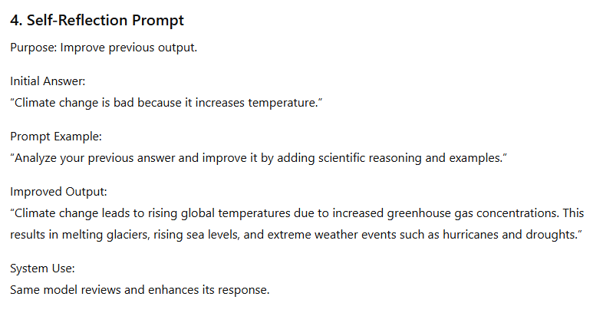

Slide 27
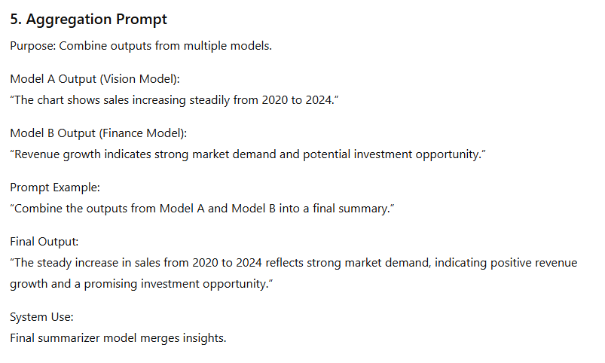

Slide 28
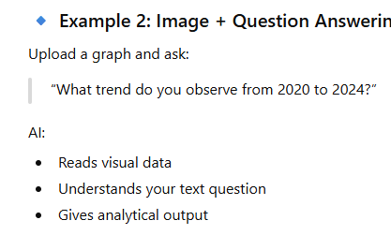
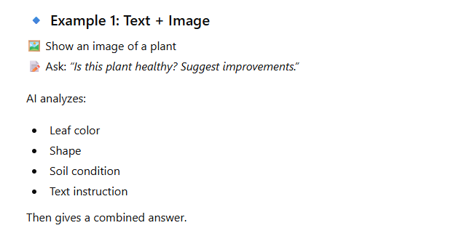
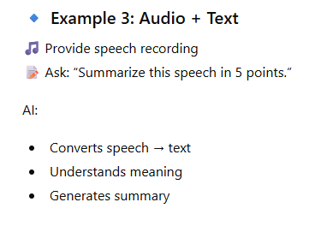
Multi-Modal Prompting Using more than one type of input to guide AI responses. Text + Image Prompts

Slide 29
Text + Image
Text + Image (multimodal) models understand visual content and written instructions together. They convert both into shared embeddings (vector representations), reason across them, and generate meaningful outputs.
This makes prompts more powerful, precise, and context-aware than text-only models.

Slide 30
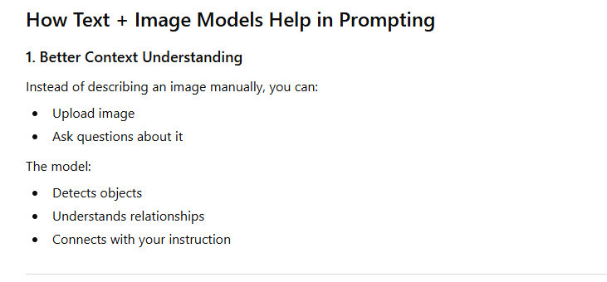
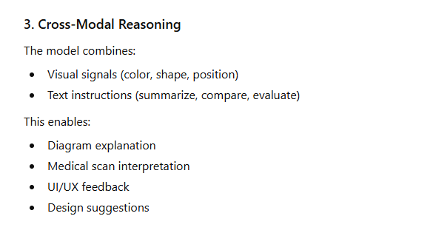
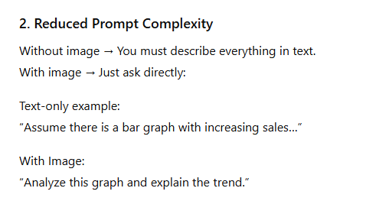
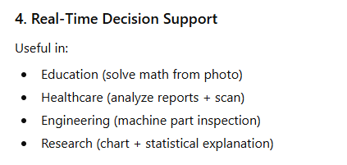

Slide 31
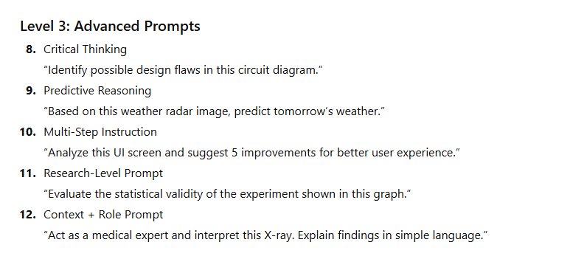
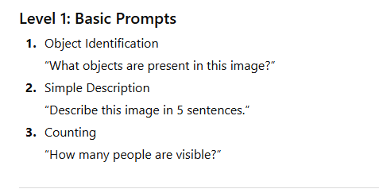
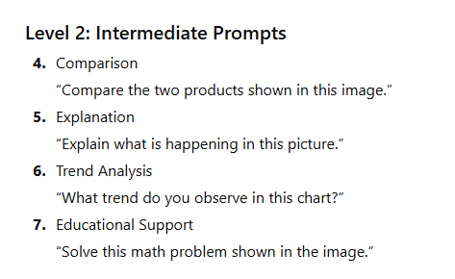
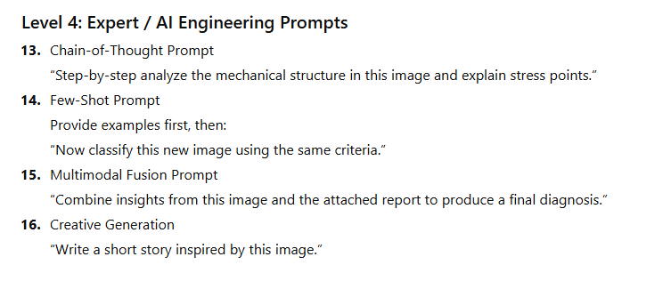

Slide 32
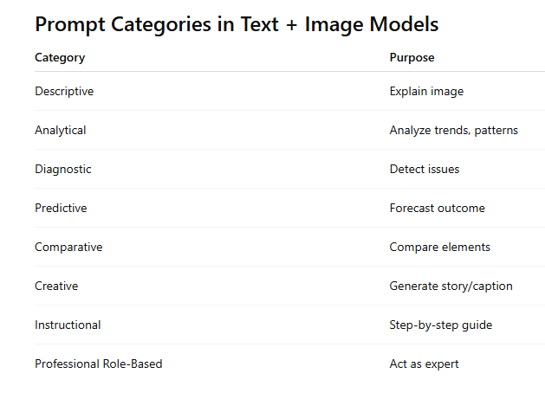

Slide 33
Cross-Model AI Interaction
Cross-Model AI Interaction refers to a system where multiple AI models communicate, collaborate, and exchange outputs to solve a task more effectively than a single model.
Instead of working independently, models:
Share intermediate results
Validate each other
Refine outputs
Specialize in subtasks
It is a core concept in advanced Prompt Engineering and AI Agent systems.

Slide 34
Why Cross-Model Interaction is Needed
Single model limitations:
Limited specialization
Possible hallucinations
Reduced accuracy in complex tasks
Cross-model systems improve:
Accuracy
Reliability
Task decomposition
Domain specialization

Slide 35
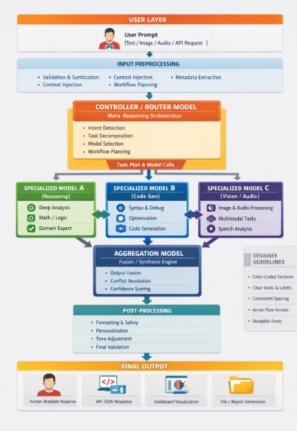

Slide 36
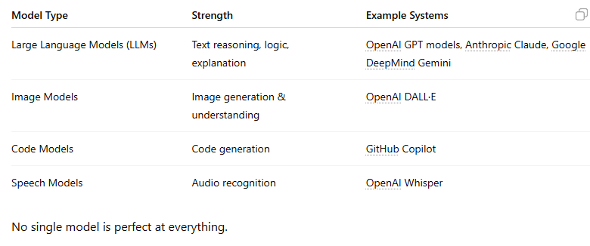
Why Cross Model

Slide 37
Prompt Engineering Techniques for Cross-Model Systems
1. Role-Specific Prompting
Each model gets a tailored prompt.
Example:
Text model → “Provide structured JSON schema”
Image model → “Generate vector infographic in flat design”

Slide 38
2. Output Formatting Control
Force structured outputs:
{
"intent": "diagram_generation",
"complexity": "high",
"modality": "image"
}
Helps routing engines.

Slide 39
Model-Aware Prompt Adaptation
Different models require:
Different token lengths
Different temperature settings
Different instruction styles
Example:
Claude prefers detailed context.
GPT responds well to structured instruction.
Gemini handles multi-modal inputs strongly.

Slide 40
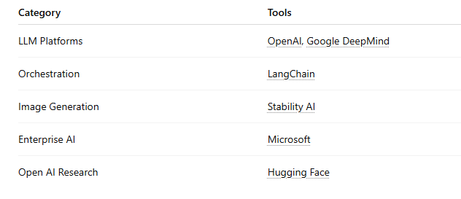
Core PE Tools

